Slide 1
Machine Learning
By - Ashwin Surse

Slide 2
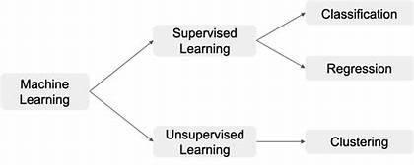
ML

Slide 3
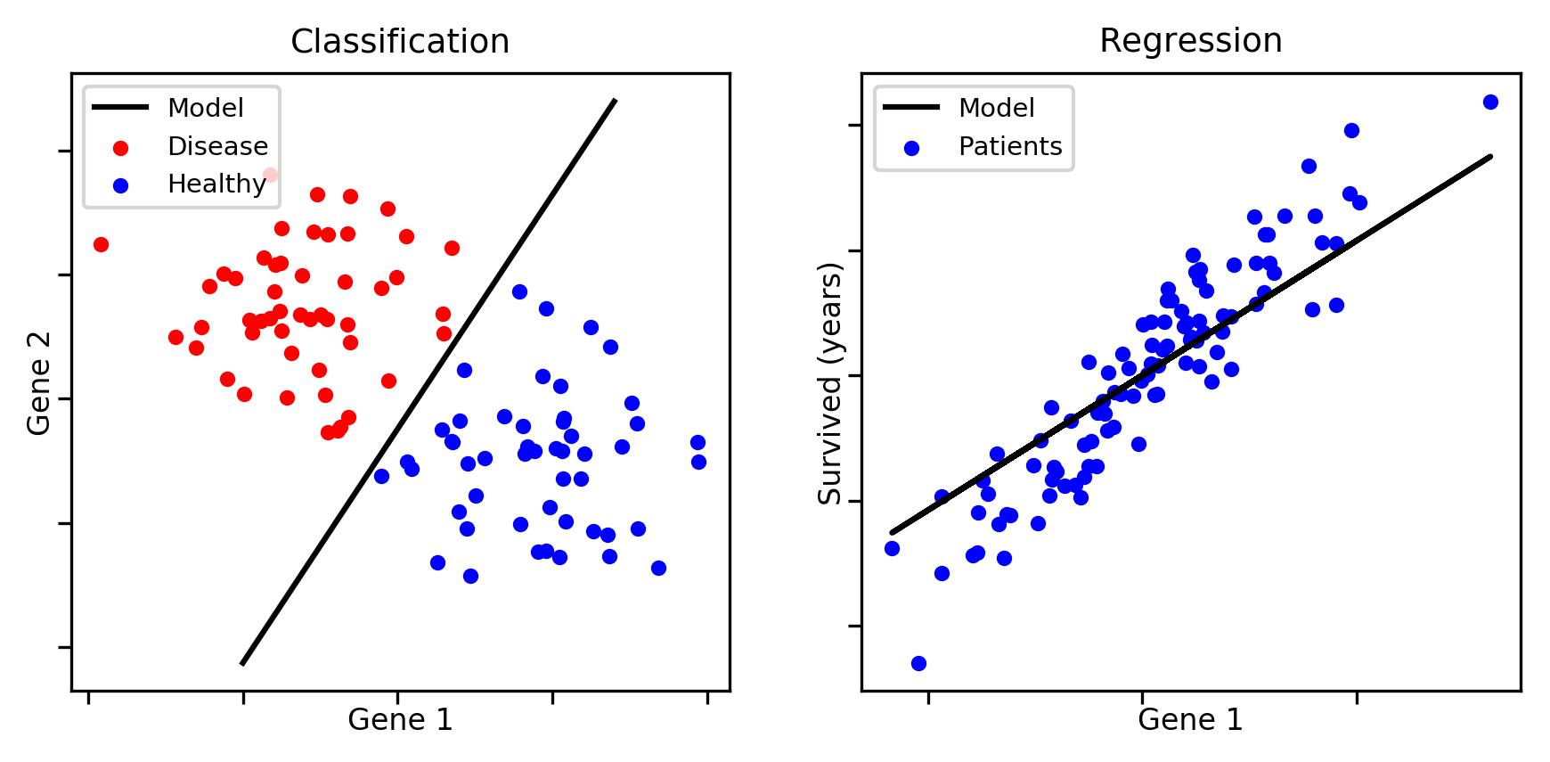
Classification and Regression

Slide 4
Classification
Classification is a process of finding a function which helps in dividing the dataset into classes based on different parameters. In Classification, a computer program is trained on the training dataset and based on that training, it categorizes the data into different classes.

Slide 5
Regression
Regression is a process of finding the correlations between dependent and independent variables. It helps in predicting the continuous variables such as prediction of Market Trends, prediction of House prices, etc.

Slide 6
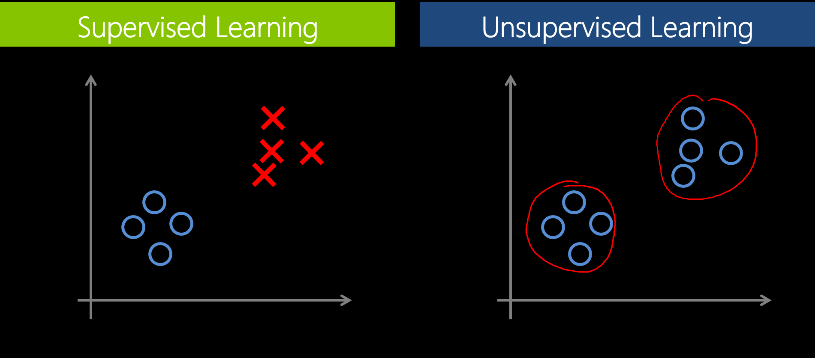
Supervised and Unsupervised

Slide 7
Supervised learning
Supervised learning is the types of machine learning in which machines are trained using well "labelled" training data, and on basis of that data, machines predict the output. The labelled data means some input data is already tagged with the correct output.
In supervised learning, the training data provided to the machines work as the supervisor that teaches the machines to predict the output correctly. It applies the same concept as a student learns in the supervision of the teacher.
Supervised learning is a process of providing input data as well as correct output data to the machine learning model. The aim of a supervised learning algorithm is to find a mapping function to map the input variable(x) with the output variable(y).

Slide 8
Advantages of Supervised learning:
With the help of supervised learning, the model can predict the output on the basis of prior experiences.
In supervised learning, we can have an exact idea about the classes of objects.
Supervised learning model helps us to solve various real-world problems such as fraud detection, spam filtering, etc.
Disadvantages of supervised learning:
Supervised learning models are not suitable for handling the complex tasks.
Supervised learning cannot predict the correct output if the test data is different from the training dataset.
Training required lots of computation times.
In supervised learning, we need enough knowledge about the classes of object.

Slide 9
unsupervised learning
unsupervised learning is a machine learning technique in which models are not supervised using training dataset. Instead, models itself find the hidden patterns and insights from the given data. It can be compared to learning which takes place in the human brain while learning new things.
Unsupervised learning is a type of machine learning in which models are trained using unlabeled dataset and are allowed to act on that data without any supervision.
Advantages of Unsupervised Learning
Unsupervised learning is used for more complex tasks as compared to supervised learning because, in unsupervised learning, we don't have labeled input data.
Unsupervised learning is preferable as it is easy to get unlabeled data in comparison to labeled data.
Disadvantages of Unsupervised Learning
Unsupervised learning is intrinsically more difficult than supervised learning as it does not have corresponding output.
The result of the unsupervised learning algorithm might be less accurate as input data is not labeled, and algorithms do not know the exact output in advance.

Slide 10
Exploratory Data analysis
exploratory data analysis is an approach of analyzing data sets to summarize their main characteristics, often using statistical graphics and other data visualization methods.

Slide 11
TYPES OF EXPLORATORY DATA ANALYSIS:
Univariate
Bivariate
Multicollinearity
Missing Values

Slide 12
Univariate :
involving a single variable
does not deal with causes or relationships
central tendency - mean, mode, median
dispersion - range, variance, max, min,quartiles, standard deviation.
bar graph, histogram, pie chart, linegraph, box plot.

Slide 13
Bivariate:
involving two variables
deals with causes or relationships.
analysis of two variables simultaneously.
correlations.
tables where one variable is contingent on the values of the other variable.
independent and dependent variables

Slide 14
multicollinearity :
A collinearity is a when two or more variables are exactly correlated.
Missing Values:
Missing data (or missing values) appear when no value is available in one or more variables of an individual.

Slide 15
Confusion Matrix:
The confusion matrix is a matrix used to determine the performance of the classification models for a given set of test data. It can only be determined if the true values for test data are known. The matrix itself can be easily understood, but the related terminologies may be confusing.

Slide 16
The matrix is divided into two dimensions, that are predicted values and actual values along with the total number of predictions.
Predicted values are those values, which are predicted by the model, and actual values are the true values for the given observations.

Slide 17
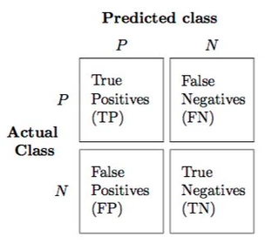
True-positive(TP): TP is correct positive prediction means that the actual value was positive and the model predicted a positive value.
False-negative(FN): FN is incorrect negative prediction means that the actual value was positive but the model predicted a negative value. It is also known as the Type 2 error.
False-positive(FP): FP is incorrect positive prediction means that the actual value was negative but the model predicted a positive value. It is also known as the Type 1 error.
True-negative(TN): TN is correct negative prediction means that the actual value was negative and the model predicted a negative value.

Slide 18
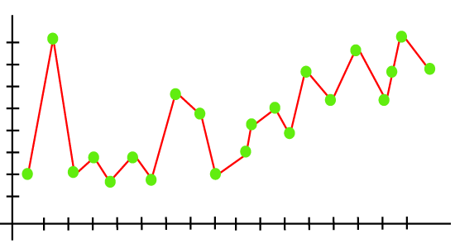
Overfitting:

Slide 19
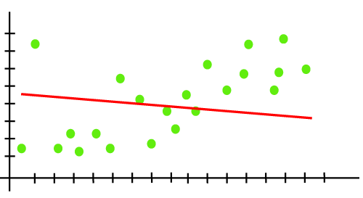
Underfitting:

Slide 20
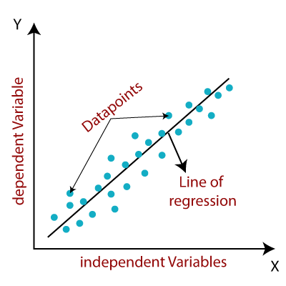
Linear Regression:

Slide 21
Linear regression is one of the easiest and most popular Machine Learning algorithms. It is a statistical method that is used for predictive analysis. Linear regression makes predictions for continuous/real or numeric variables such as sales, salary, age, product price, etc.

Slide 22
y= a0+a1x+ ε
Y= Dependent Variable (Target Variable)
X= Independent Variable (predictor Variable)
a0= intercept of the line (Gives an additional degree of freedom)
a1 = Linear regression coefficient (scale factor to each input value).
ε = random error

Slide 23
Types of Linear Regression
Simple Linear Regression:
If a single independent variable is used to predict the value of a numerical dependent variable, then such a Linear Regression algorithm is called Simple Linear Regression.
Multiple Linear regression:
If more than one independent variable is used to predict the value of a numerical dependent variable, then such a Linear Regression algorithm is called Multiple Linear Regression.

Slide 24
Positive Linear Relationship:
If the dependent variable increases on the Y-axis and independent variable increases on X-axis, then such a relationship is termed as a Positive linear relationship.
Negative Linear Relationship:
If the dependent variable decreases on the Y-axis and independent variable increases on the X-axis, then such a relationship is called a negative linear relationship.

Slide 25
What is feature engineering?
Training data consists of a matrix composed of rows and columns. Each row in the matrix is an observation or record. The columns of each row are the features that describe each record. The features specified in the experimental design should characterize the patterns in the data.
Although many of the raw data fields can be used directly to train a model, it's often necessary to create additional (engineered) features for an enhanced training dataset.
Engineered features that enhance training provide information that better differentiates the patterns in the data. But this process is something of an art. Sound and productive decisions often require domain expertise.

Slide 26
Feature engineering: The process of creating new features from raw data to increase the predictive power of the learning algorithm. Engineered features should capture additional information that is not easily apparent in the original feature set.
Feature selection: The process of selecting the key subset of features to reduce the dimensionality of the training problem.

Slide 27
Feature engineering is the process of transforming raw data into features that better represent the underlying problem to the predictive models, resulting in improved model accuracy on unseen data.
Feature engineering is a key component in building reliable and predictive machine learning models. By using domain knowledge of the data at hand, data scientists are able to create features that make machine learning algorithms work.

Slide 28
Label Encoding
In machine learning, we usually deal with datasets which contains multiple labels in one or more than one columns. These labels can be in the form of words or numbers. To make the data understandable or in human readable form, the training data is often labeled in words.
Label Encoding refers to converting the labels into numeric form so as to convert it into the machine-readable form. Machine learning algorithms can then decide in a better way on how those labels must be operated. It is an important pre-processing step for the structured dataset in supervised learning.

Slide 29
Limitation of label Encoding
Label encoding convert the data in machine readable form, but it assigns a unique number(starting from 0) to each class of data. This may lead to the generation of priority issue in training of data sets. A label with high value may be considered to have high priority than a label having lower value.

Slide 30
What is One-Hot Encoding?
One-hot encoding is used in machine learning as a method to quantify categorical data. In short, this method produces a vector with length equal to the number of categories in the data set. If a data point belongs to the
ith category then components of this vector are assigned the value 0 except for the ith component, which is assigned a value of 1. In this way one can keep track of the categories in a numerically meaningful way.

Slide 31
Principal Component Analysis(PCA)
Principal Component Analysis is an unsupervised learning algorithm that is used for the dimensionality reduction in machine learning. It is a statistical process that converts the observations of correlated features into a set of linearly uncorrelated features with the help of orthogonal transformation.
PCA generally tries to find the lower-dimensional surface to project the high-dimensional data.

Slide 32
Cluster Analysis
It is an unsupervised learning method, hence no supervision is provided to the algorithm, and it deals with the unlabeled dataset.

Slide 33
Forward Selection & Backward Selection
Forward Selection
Forward selection is a variable selection method.
Begins with a model that contains no variables (called the Null Model)
Then starts adding the most significant variables one after the other
Until a pre-specified stopping rule is reached or until all the variables under consideration are included in the model
Backward Selection
Backward selection is a variable selection method.
Begins with a model that contains all variables under consideration (called the Full Model)
Then starts removing the least significant variables one after the other
Until a pre-specified stopping rule is reached or until no variable is left in the model

Slide 34
LASSO & Ridge
LASSO (least absolute shrinkage and selection operator) is similar to linear regression. However, it uses the approach of absolute shrinkage and selection to reduce the value of incorrectly estimated coefficients. This helps in reducing overfitting. Another term used for lasso is L1-norm regularization.
Ridge regression is also similar to linear regression or you can say regularized linear regression. It minimizes the Residual Sum of Squares(RSS) in the linear regression to fit the training dataset. In Ridge regression, we add the square of the magnitude of weights to the loss function of linear regression. It acts as a penalty and helps in reducing the overfitting for a given dataset. It is also known as L1 regularization.

Slide 35
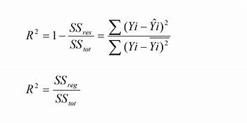
R

Slide 36

Support Vector Machine

Slide 37
Support Vector Machine or SVM is one of the most popular Supervised Learning algorithms, which is used for Classification as well as Regression problems. However, primarily, it is used for Classification problems in Machine Learning.
The goal of the SVM algorithm is to create the best line or decision boundary that can segregate n-dimensional space into classes so that we can easily put the new data point in the correct category in the future. This best decision boundary is called a hyperplane.

Slide 38
Support Vectors:
The data points or vectors that are the closest to the hyperplane and which affect the position of the hyperplane are termed as Support Vector. Since these vectors support the hyperplane, hence called a Support vector.
Hyperplane:
There can be multiple lines/decision boundaries to segregate the classes in n-dimensional space, but we need to find out the best decision boundary that helps to classify the data points. This best boundary is known as the hyperplane of SVM.
The dimensions of the hyperplane depend on the features present in the dataset, which means if there are 2 features (as shown in image), then hyperplane will be a straight line. And if there are 3 features, then hyperplane will be a 2-dimension plane.

Slide 39
Decision Tree Classification Algorithm
Decision Tree is a Supervised learning technique that can be used for both classification and Regression problems, but mostly it is preferred for solving Classification problems.
It is a tree-structured classifier, where internal nodes represent the features of a dataset, branches represent the decision rules and each leaf node represents the outcome.
It is a graphical representation for getting all the possible solutions to a problem/decision based on given conditions.
It is called a decision tree because, similar to a tree, it starts with the root node, which expands on further branches and constructs a tree-like structure.

Slide 40
Root Node: Root node is from where the decision tree starts. It represents the entire dataset, which further gets divided into two or more homogeneous sets.
Leaf Node: Leaf nodes are the final output node, and the tree cannot be segregated further after getting a leaf node.
Splitting: Splitting is the process of dividing the decision node/root node into sub-nodes according to the given conditions.
Branch/Sub Tree: A tree formed by splitting the tree.
Pruning: Pruning is the process of removing the unwanted branches from the tree.
Parent/Child node: The root node of the tree is called the parent node, and other nodes are called the child nodes.

Slide 41
Information Gain:
Information gain is the measurement of changes in entropy after the segmentation of a dataset based on an attribute.
It calculates how much information a feature provides us about a class.
According to the value of information gain, we split the node and build the decision tree.
Formula: Information Gain= Entropy(S)- [(Weighted Avg) *Entropy(eachfeature)

Slide 42
Gini Index:
Gini index is a measure of impurity or purity used while creating a decision tree in the CART(Classification and Regression Tree) algorithm.
An attribute with the low Gini index should be preferred as compared to the high Gini index.
It only creates binary splits, and the CART algorithm uses the Gini index to create binary splits.
Gini index can be calculated using the below formula:
Gini Index= 1- ∑jPj2

Slide 43
ADA Boosting
AdaBoost algorithm, short for Adaptive Boosting, is a Boosting technique used as an Ensemble Method in Machine Learning. It is called Adaptive Boosting as the weights are re-assigned to each instance, with higher weights assigned to incorrectly classified instances. Boosting is used to reduce bias as well as variance for supervised learning. It works on the principle of learners growing sequentially.
It makes ‘n’ number of decision trees during the data training period. As the first decision tree/model is made, the incorrectly classified record in the first model is given priority. Only these records are sent as input for the second model. The process goes on until we specify a number of base learners we want to create. Remember, repetition of records is allowed with all boosting techniques.

Slide 44
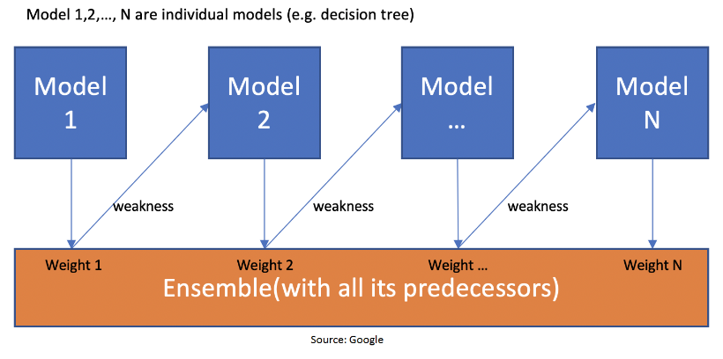

Slide 45
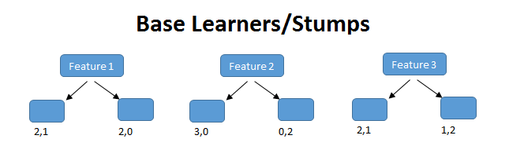

Slide 46
Random Forest Algorithm
Random Forest is a popular machine learning algorithm that belongs to the supervised learning technique. It can be used for both Classification and Regression problems in ML. It is based on the concept of ensemble learning, which is a process of combining multiple classifiers to solve a complex problem and to improve the performance of the model.
"Random Forest is a classifier that contains a number of decision trees on various subsets of the given dataset and takes the average to improve the predictive accuracy of that dataset."
The greater number of trees in the forest leads to higher accuracy and prevents the problem of overfitting.

Slide 47
Why use Random Forest?
It takes less training time as compared to other algorithms.
It predicts output with high accuracy, even for the large dataset it runs efficiently.
It can also maintain accuracy when a large proportion of data is missing.

Slide 48
Advantages of Random Forest
Random Forest is capable of performing both Classification and Regression tasks.
It is capable of handling large datasets with high dimensionality.
It enhances the accuracy of the model and prevents the overfitting issue.
Disadvantages of Random Forest
Although random forest can be used for both classification and regression tasks, it is not more suitable for Regression tasks.

